Slide 1
LINUX AND SHELL SCRIPTING

Slide 2
Learning Outcomes
Understand the filesystem

Slide 3
The Filesystem
A filesystem is a set of data structures that usually resides on part of a disk and that holds directories of files.
Filesystems store user and system data that are the basis of users’ work on the system and the system’s existence.

Slide 4
The Hierarchical Filesystem
A hierarchical structure frequently takes the shape of a pyramid.
One example: a family’s lineage.
A couple has a child, who may in turn have several children, each of whom may have more children.
This hierarchical structure is called a family tree

Slide 5

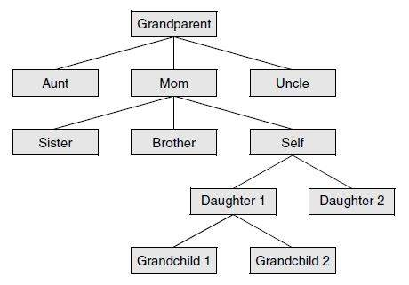
A family tree

Slide 6
Tree
Like the family tree it resembles, the Linux filesystem is called a tree.
It consists of a set of connected files.
This structure allows you to organize files so you can easily find any particular one.

Slide 7
Tree
On a standard Linux system, each user starts with one directory, to which the user can add subdirectories to any desired level.
By creating multiple levels of subdirectories, a user can expand the structure as needed.

Slide 8
Tree
Typically each subdirectory is dedicated to a single subject, such as a person, project, or event.
The subject dictates whether a subdirectory should be subdivided further. For example, a secretary’s subdirectory named correspond.

Slide 9

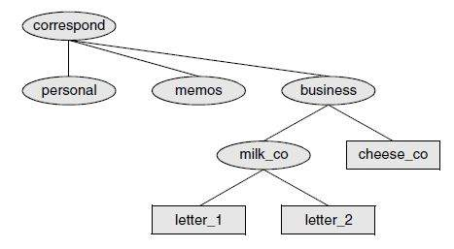
A secretary’s directories

Slide 10
The Hierarchical Filesystem
This directory contains three subdirectories: business, memos, and personal.
The business directory contains files that store each letter the secretary types.

Slide 11
Strength of Linux FileSystem
One major strength of the Linux filesystem is its ability to adapt to users’ needs.
You can take advantage of this strength by strategically organizing your files so they are most convenient and useful for you.

Slide 12
Directory Files and Ordinary Files
Like a family tree, the tree representing the filesystem is usually pictured upside down, with its root at the top.
The tree “grows” downward from the root, with paths connecting the root to each of the other files. At the end of each path is either an ordinary file or a directory file.

Slide 13
Directory Files and Ordinary Files
Ordinary files, or simply files, appear at the ends of paths that cannot support other paths.
Directory files, also referred to as directories or folders, are the points that other paths can branch off from.

Slide 14
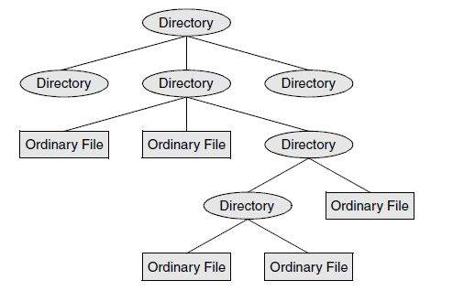
Directory Files and Ordinary Files

Slide 15
Directory Files and Ordinary Files
When you refer to the tree, up is toward the root and down is away from the root.
Directories directly connected by a path are called parents (closer to the root) and children (farther from the root).
A pathname is a series of names that trace a path along branches from one file to another.

Slide 16
Filenames
Every file has a filename.
The maximum length of a filename varies with the type of filesystem; Linux supports several types of filesystems.
Although most of today’s filesystems allow files with names up to 255 characters long, some filesystems restrict filenames to fewer characters.

Slide 17
Filenames
Choose characters from the following list:
  Uppercase letters (A–Z)
  Lowercase letters (a–z)
  Numbers (0–9)
  Underscore (_)
  Period (.)
  Comma (,)

Slide 18
Filenames
Like the children of one parent, no two files in the same directory can have the same name.
Files in different directories, like the children of different parents, can have the same name.

Slide 19
Filenames
The filenames you choose should mean something. Too often a directory is filled with important files with such unhelpful names as hold1, wombat, and junk, not to mention foo and foobar.
Such names are poor choices because they do not help you recall what you stored in a file.

Slide 20
Filenames
The following filenames conform to the suggested syntax and convey information about the contents of the file:
  Correspond
  January
  Davis
  Reports
  2001
  acct_payable

Slide 21
Filenames
If you keep the filenames short, they are easy to type.
The disadvantage of short filenames is that they are typically less descriptive than long filenames.

Slide 22
Filenames
Long filenames enable you to assign descriptive names to files.
To help you select among files without typing entire filenames, shells support filename completion.

Slide 23
Filenames
You can use uppercase and/or lowercase letters within filenames, but be careful: Many filesystems are case sensitive.
For example, the popular ext family of filesystems and the UFS filesystem are case sensitive, so files named JANUARY, January, and january refer to three distinct files.

Slide 24
Filenames
The FAT family of filesystems (used mostly for removable media) is not case sensitive, so those three filenames represent the same file.
The HFS+ filesystem, which is the default OS X filesystem, is case preserving but not case sensitive.

Slide 25
Filenames
Although you can use SPACEs within filenames, it is a poor idea. Because a SPACE is a special character, you must quote it on a command line.
Use periods or underscores instead of SPACEs: joe.05.04.26, new_stuff.
$ lpr my\ file
$ lpr "my file"

Slide 26
Filename Extensions
A filename extension is the part of the filename following an embedded period.
The filename extensions help describe the contents of the file.

Slide 27
Filename Extensions
Filename with Extension | Meaning of Extension
compute.c | A C programming language source file
compute.o | The object code file of compute.c
compute | The executable file of compute.c
memo-0410.txt | A text file
memo.pdf | A PDF file, view with xpdf or kpdf
memo.ps | A PostScript file, view with gs or kpdf
memo.z | A file compressed wih compress; use uncompress or gunzip to decompress

Slide 28
Filename Extensions
Filename with Extension | Meaning of Extension
Memo.tgz or memo.tar.gz | A tar archive of files compressed with gzip
Memo.gz | A file compressed with gzip, view with zcat or decompress with gunzip
Memo.bz2 | A file compressed with bzip2; view with bzcat or decompress with bunzip2
Memo.html | A file meant to be viewed using a Web browser, such as firefox
.gif, .jpg, .jpeg, .bmp, .tif or .tiff | A file containing graphical information, such as picture

Slide 29
Hidden Filenames
A filename that begins with a period is called a hidden filename because ls does not normally display it.
The command ls –a displays all filenames, even hidden ones.
Names of startup files usually begin with a period so that they are hidden and do not clutter a directory listing.

Slide 30
Hidden Filenames
The .plan file is also hidden. Two special hidden entries—a single and double period (. and ..)—appear in every directory.

Slide 31
The Working Directory
While you are logged in on a Linux system, you are always associated with a directory. The directory you are associated with is called the working directory or current directory.

Slide 32
The Working Directory
The pwd (print working directory) shell builtin displays the pathname of the working directory.

Slide 33
Your Home Directory
When you first log in, the working directory is your home directory. To display the pathname of your home directory, use pwd just after you log in.
Linux home directories are typically located in /home

Slide 34
Your Home Directory
When used without any arguments, the ls utility displays a list of the files in the working directory.
All the files you have created up to this point were created in your home directory.

Slide 35
Startup Files
Startup files, which appear in your home directory, give the shell and other programs information about you and your preferences.

Slide 36
Startup Files
Because the startup files have hidden filenames, you must use the ls –a command to see whether one is in your home directory.

